Slide 1
MODULE III

Slide 2
Syllabus
Polymorphism – Runtime and compile time polymorphism ,
overloading functions and operators, selecting friend member function for operator overloading , Virtual methods –
pure virtual methods – Abstract classes - applications of abstract classes.

Slide 3
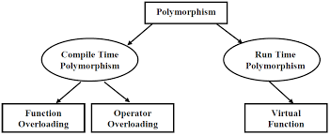
Polymorphism
Means one name , multiple forms.

Slide 4
Compile time polymorphism: -
The overloaded member functions are ‘selected’ for invoking by matching arguments, both type and number.
This information is known to the compiler at compile time and therefore is able to select appropriate function for a particular call at compile time itself.
This is called early binding , or static binding ,static linking or compile time polymorphism.

Slide 5
Function overloading
Using the same function name to create functions that perform a variety of different tasks.
Function overloading is the general concept of C++ which is not available with C.
The correct function to be invoked is determined by checking the number and type of arguments and not on the function type.
The languages Perl and Haskell overload by return type but other common OO languages does not support overloading by return type.
-- C++ also does not support overloading by return type. Its does overloading based on
types of parameters
number of parameters

Slide 6
Example of function overloading
int test() { }
int test(int a){ }
int test(double a){ }
Int test(int a, double b){ }
int test(int a){ }
double test(int b){ }
Compiler shows error in this case.

Slide 7
Example 1
int operate (int a, int b)
{
return (a*b);
}
double operate (double a, double b)
{
return (a/b);
}
int main ()
{
int x=5,y=2;
double n=5.0,m=2.0;
cout << operate (x,y) << '\n';
cout << operate (n,m) << '\n';
return 0;
}

Slide 8
How function calls are matched with overloaded functions
Making a call to an overloaded function results in one of three possible outcomes:
A match is found. The call is resolved to a particular overloaded function.
No match is found. The arguments cannot be matched to any overloaded function.
An ambiguous match is found. The arguments matched more than one overloaded function.
When an overloaded function is called, C++ goes through the following process to determine which version of the function will be called:
First, C++ tries to find an exact match. This is the case where the actual argument exactly matches the parameter type of one of the overloaded functions. For example:
void print(char *value);
void print(int value);
print(0); // exact match with print(int)
Although 0 could technically match print(char*) (as a null pointer), it exactly matches print(int). Thus print(int) is the best match available.

Slide 9
2) If no exact match is found, C++ tries to find a match through promotion. Certain types can be automatically promoted via internal type conversion to other types.
To summarize,
- Char, unsigned char, and short is promoted to an int.
- Unsigned short can be promoted to int or unsigned int, depending on the size of an int
- Float is promoted to double
For example:
void print(char *value);
void print(int value);
print('a'); // promoted to match print(int)
In this case, because there is no print(char), the char ‘a’ is promoted to an integer, which then matches print(int).

Slide 10
3) If no promotion is found, C++ tries to find a match through standard built in conversion.
Standard conversions include:
a. Any numeric type will match any other numeric type, including unsigned (eg. int to float)
b. Zero will match a pointer type and numeric type (eg. 0 to char*, or 0 to float)
For example:
struct Employee; // defined somewhere else
void print(float value);
void print(Employee value);
print('a'); // 'a' converted to match print(float)
In this case, because there is no print(char), and no print(int), the ‘a’ is converted to a float and matched with print(float).

Slide 11
Ambiguous matches
void print(unsigned int value);
void print(float value);
print('a');
print(0);
print(3.14159);
………………………………………………….
In the case of print('a'), C++ can not find an exact match. It tries promoting ‘a’ to an int, but there is no print(int) either. Using a standard conversion, it can convert ‘a’ to both an unsigned int and a floating point value. Because all standard conversions are considered equal, this is an ambiguous match.
b. print(0) is similar. 0 is an int, and there is no print(int). It matches both calls via standard conversion.
c. print(3.14159)
3.14159 is a double, and there is no print(double). Consequently, it matches both calls via standard conversion.
Ambiguous matches are considered as compile-time error.

Slide 12
4. If all the above steps fail, the compiler checks for user defined conversions in combination with promotions and built in conversions to find a unique match.
If that also fails, a message is displayed as no match is found.

Slide 13
Sample question
Write a program to find the volume of a cube , a sphere and a cylinder.
Use the concept of function overloading.

Slide 14
float vol(int,int);
float vol(float);
int vol(int);
int main()
{
int r,h,a;
float r1;
cout<<"Enter radius and height of a cylinder:";
cin>>r>>h;
cout<<"Enter side of cube:";
cin>>a;
cout<<"Enter radius of sphere:";
cin>>r1;
cout<<"Volume of cylinder is"<<vol(r,h);
cout<<"\nVolume of cube is"<<vol(a);
cout<<"\nVolume of sphere is"<<vol(r1);
return 0;
}
float vol(int r,int h)
{
return(3.14*r*r*h);
}
float vol(float r1)
{
return((4*3.14*r1*r1*r1)/3);
}
int vol(int a)
{
return(a*a*a);
}

Slide 15
Operator overloading
Operator overloading is an exciting feature of C++
The mechanism of giving special meaning to operator is called operator overloading.
We can overload all of the C++ operators except the following
Class member access operator( . , .*)
scope resolution operator (::)
Size of operator( sizeof())
Conditional operator (?)
By overloading , the original meaning of the operator is not lost.

Slide 16
The unary operators that can be overloaded includes the following:
! (logical NOT)
& (address-of)
~ (one's complement)
* (pointer dereference)
+ (unary plus)
- (unary negation)
++ (increment)
-- (decrement)

Slide 17
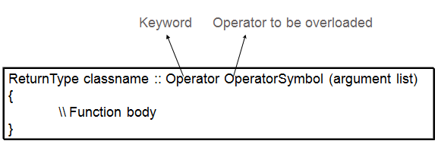
Syntax of operator overloading function
Implementing Operator Overloading
Operator overloading can be done by implementing a function which can be :
Member Function
Non-Member Function
Friend Function
Operator overloading function can be a member function if the Left operand is an Object of that class, but if the Left operand is different, then Operator overloading function must be a non-member function.
Operator overloading function can be made friend function if it needs access to the private and protected members of class.

Slide 18
Notes : -
A friend function will have only one argument for unary operators and two arguments for binary operators
A member function will have no arguments for unary and only one for binary operators.
This is because object used to invoke the member function is passed implicitly and is therefore available to the member function.
For a friend function, the arguments must be explicitly passed.

Slide 19
Restrictions
Following are some restrictions to be kept in mind while implementing operator overloading.
a. Precedence and Associativity of an operator cannot be changed.
b. Arity (numbers of Operands) cannot be changed. Unary operator remains unary, binary remains binary etc.
c. No new operators can be created, only existing operators can be overloaded.

Slide 20
unary operator overloading
The unary operators operate on a single operand and following are the examples of Unary operators:
The increment and decrement operator(++ and --)
The unary minus (-) operator.
The logical not (!) operator.
The unary operators operate on the object for which they were called and normally, this operator appears on the left side of the object, as in !obj, -obj, and ++obj.

Slide 21
Eg:- for unary op overloading – for decrementing and incrementing two complex numbers
class complex
{
int a,b,c;
public:
complex(){}
void getvalue()
{
cout<<"Enter the Two Numbers:";
cin>>a>>b;
}
void operator++()
{ a=++a;
b=++b;
}
void operator--()
{ a=--a;
b=--b;
}
void display()
{
cout<<a<<"+\t"<<b<<"i"<<endl;
}
};
int main()
{
complex obj;
obj.getvalue();
++obj;
cout<<"Increment Complex Number\n";
obj.display();
--obj;
cout<<"Decrement Complex Number\n";
obj.display();
}

Slide 22
Sample questions
Write operator overloaded programs to
a. negate a complex number(use the operator -)
b. convert the format of time from am-pm notation to 24hr notation and vice versa. (use the operator ~)
c. To negate a third degree polynomial. (use the operator !)

Slide 23
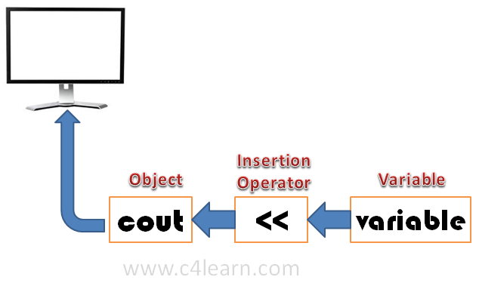
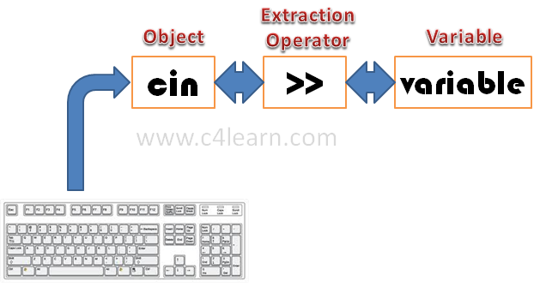
Input and output operations
cin | standard input stream
cout | standard output stream

Slide 24
binary operators
While overloading binary operators, the left-hand operand calls the operator function and the right-hand operator is used as argument.
The friend functions can be used alternatively with member functions for overloading of binary operators. The friend function requires two operands to be passed as arguments.
The binary operators take two arguments .
Frequently used binary operators are addition (+) operator, subtraction (-) operator and division (/) operator , multiplication (*) etc..

Slide 25
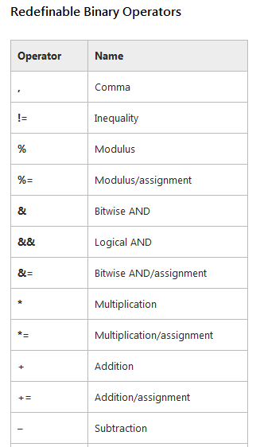
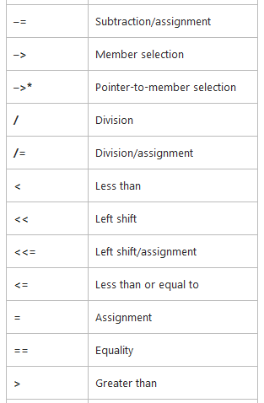
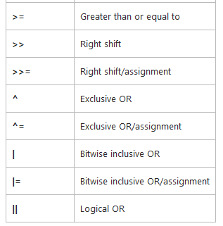
The following table shows a list of operators that can be overloaded.

Slide 26
Advantage..
A statement like c = sum(a,b) can be replaced by a natural looking expression ,
c = a+b; by overloading the + operator using an operator+() function

Slide 27
Binary operator overloading eg:- ( As member function )- To add two complex numbers
class overloading
{
int a,b;
public:
void setValue(int p,int q)
{ a =p;
b =q;
}
overloading operator+(overloading ob)
{
overloading t;
t.a=a+ob.a;
t.b=b+ob.b;
return(t);
}
void display()
{
cout<<a<<"+"<<b<<"i"<<endl;
} };
int main()
{
overloading obj1,obj2,result;
int a,b;
cout<<"Enter the value of first Complex Number :";
cin>>a>>b;
obj1.setValue(a,b);
cout<<"Enter the value of second Complex Number :";
cin>>a>>b;
obj2.setValue(a,b);
result = obj1+obj2;
cout<<"Input Values:\n";
obj1.display();
obj2.display();
cout<<"Result:";
result.display();
}

Slide 28
Previous pgm – Using friend
class overloading
{
int a,b;
public:
void setValue(int p,int q)
{ a =p;
b =q;
}
friend overloading operator+(overloading ob1,overloading ob2);
void display()
{
cout<<a<<"+"<<b<<"i"<<endl;
} };
overloading operator+(overloading ob1,overloading ob2)
{
overloading t;
t.a=ob1.a+ob2.a;
t.b=ob1.b+ob2.b;
return(t);
}
int main()
{
overloading obj1,obj2,result;
int a,b;
cout<<"Enter the value of first Complex Number :";
cin>>a>>b;
obj1.setValue(a,b);
cout<<"Enter the value of second Complex No :";
cin>>a>>b;
obj2.setValue(a,b);
result = obj1+obj2;
cout<<"Input Values:\n";
obj1.display();
obj2.display();
cout<<"Result:";
result.display();
}

Slide 29
Sample questions
1 . Write a menu driven program to add / subtract two 2nd degree polynomials , to multiply a polynomial with a constant number.
2. Using the concept of friend and operator overloading, WAP to compare two string values.

